Slide 1

Object detection on PandaSet
Giovanni Schianchi mat. 352863
Francesca Stefano mat.353310

Slide 2

PROJECT GOAL & DATASET
Goal ➔object detection
car;
pedestrian;
tree;
….
Dataset ➔ PandaSet (from Kaggle)

Slide 3
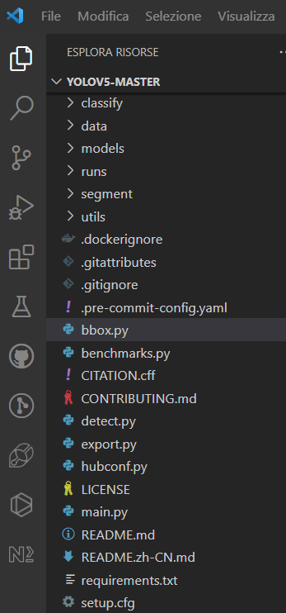
TOOLS & ALGORITHM
Python to explore dataset,
split images
Train
inference
Visual Studio as IDE
YOLOv5 as algorithm for Object Detection, in particular a pre-trained model of YOLO

Slide 4
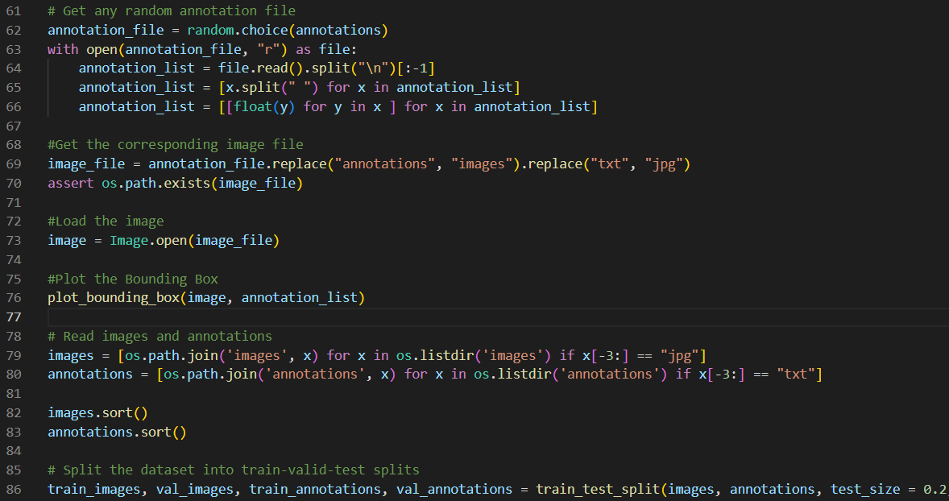

CODE
Main.py
Train.py
Detect.py

Slide 5
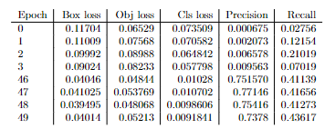
RESULTS

Slide 6
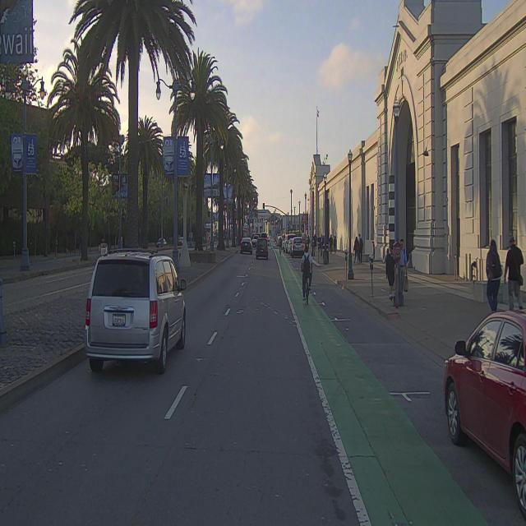
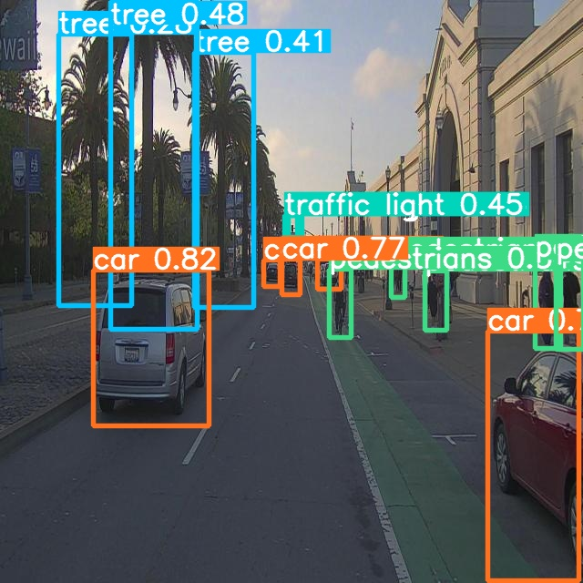

Slide 7
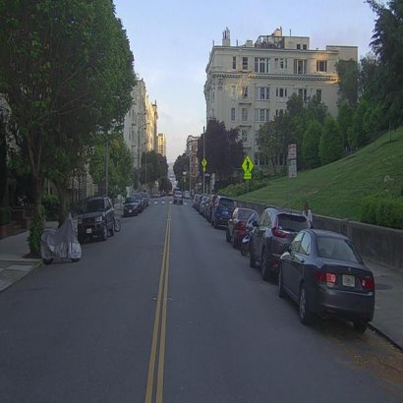
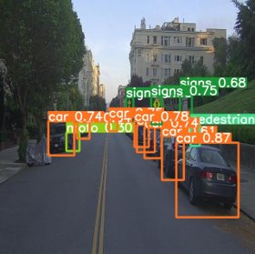

Slide 8

DIFFICULTY
Explore dataset and take annotations for every image
Re-train the new model

Slide 9
WHAT WE LEARN
Re-train a new model
Before starting a project, select(and decide) carefully what do you what to do

Slide 10


